Slide 1
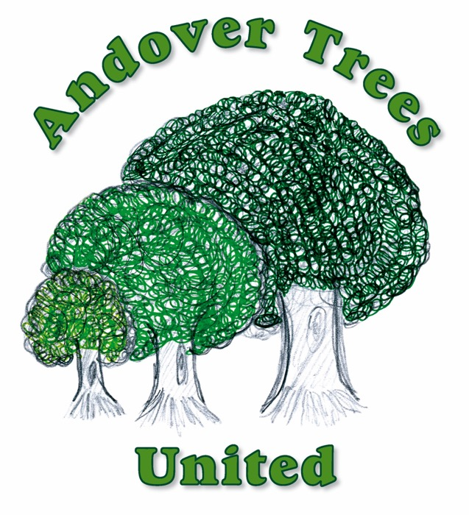
Trees!
How many do you know?

Slide 2
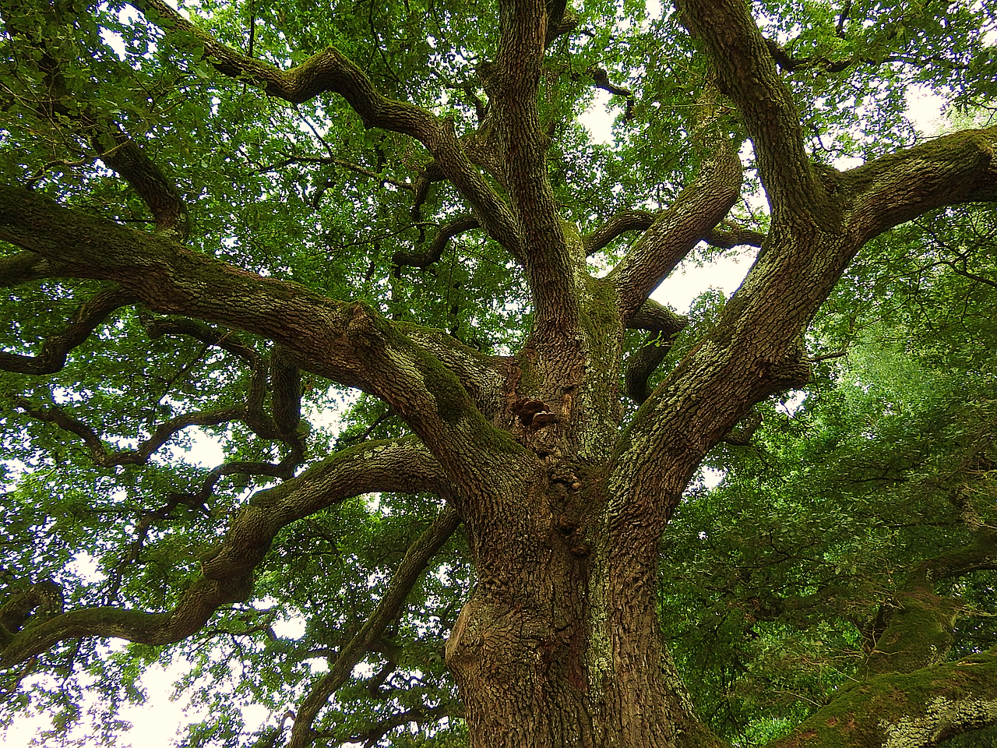
What is a British native tree?
Britain was not always a group of islands. We used to be attached to Europe.
Ancient Britain was a peninsula until, after the last ice-age, a tsunami flooded its land-links to Europe some 8,000 years ago.
Native UK trees grew on the land when the glaciers melted after the last ice-age and while the UK was still connected to mainland Europe.
British native trees have been growing on our land naturally for between 9,000 and 10,000 years.
Trees that have been brought here deliberately by people from other parts of the world are not British native trees – they are called ‘non-natives’

Slide 3
In Harmony Woods, children from all the schools in Andover and from local village schools too are planting British native trees

Slide 4
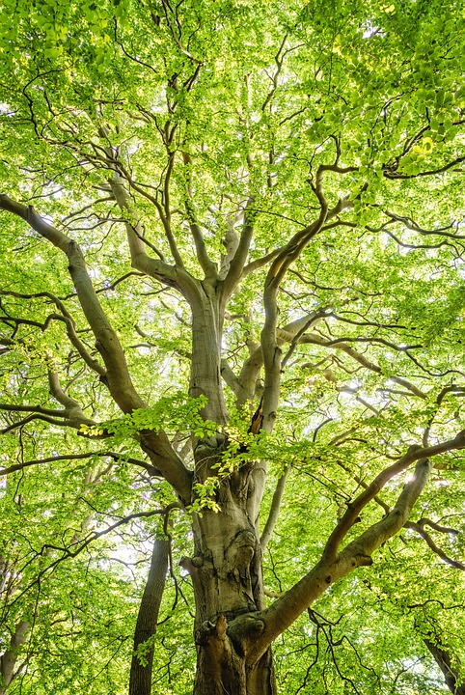
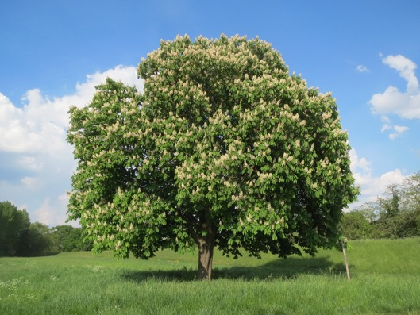
I wonder how many British trees you can think of? Could you name 6?
Count them (use your fingers)
Tell your partner how many
Tell your teacher how many

Slide 5
Do you know what the trees look like? Could you recognise 6?
How many do you think you could recognise?

Slide 6
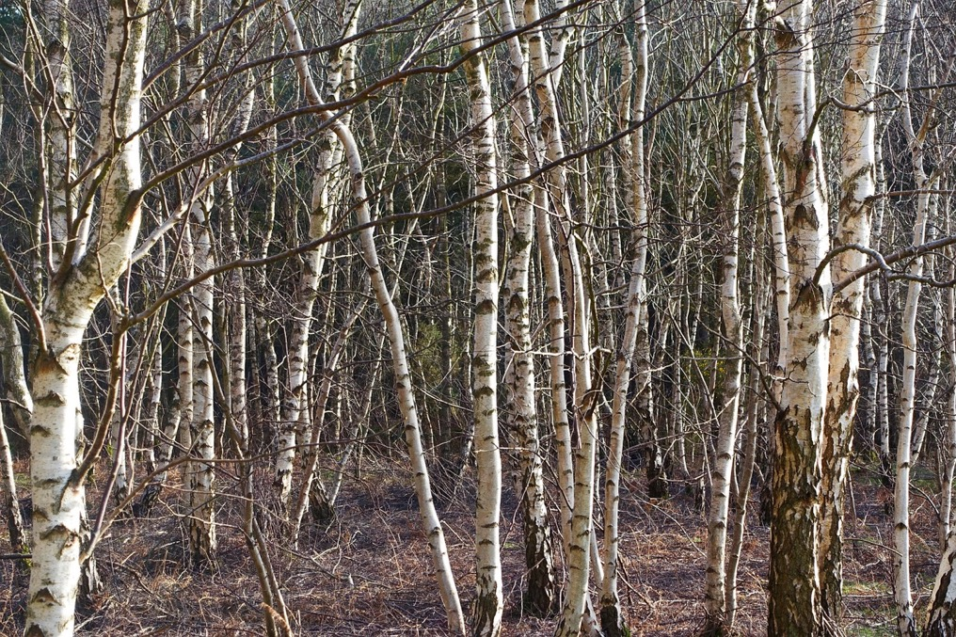
Leaf Bark in winter
1.

Slide 7
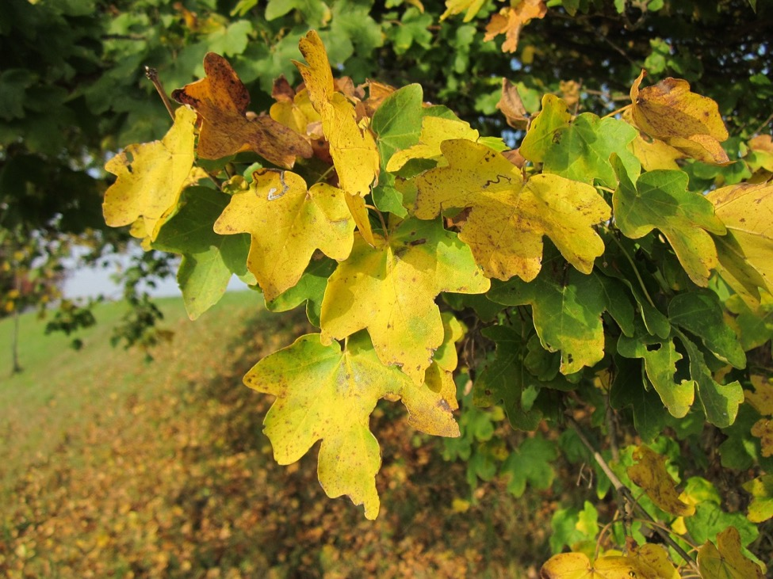
Summer leaf Autumn leaf
2.

Slide 8
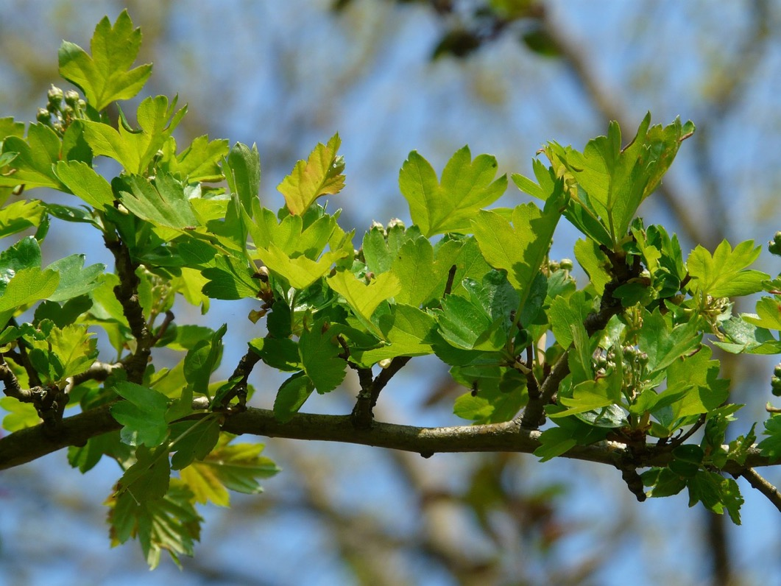
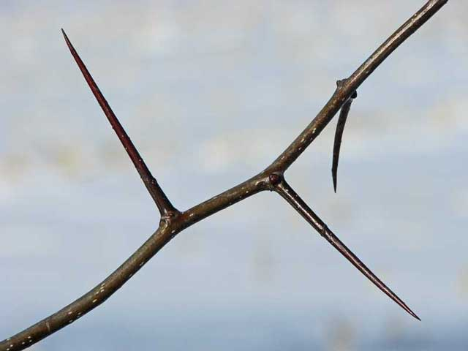
Leaf Thorn Branch with flower buds
3.

Slide 9
Leaf
4.

Slide 10
Leaf
5.

Slide 11
Leaf
6.

Slide 12
Leaf
7.

Slide 13
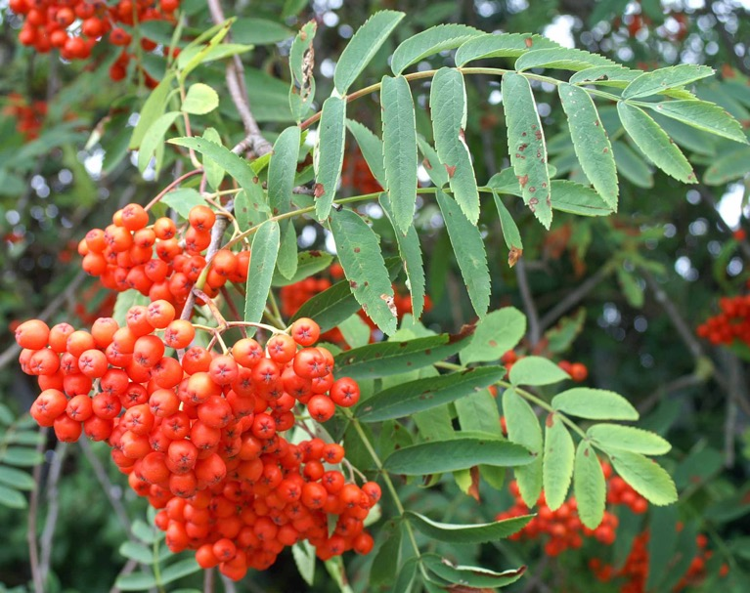
Leaf Autumn berries
8.

Slide 14
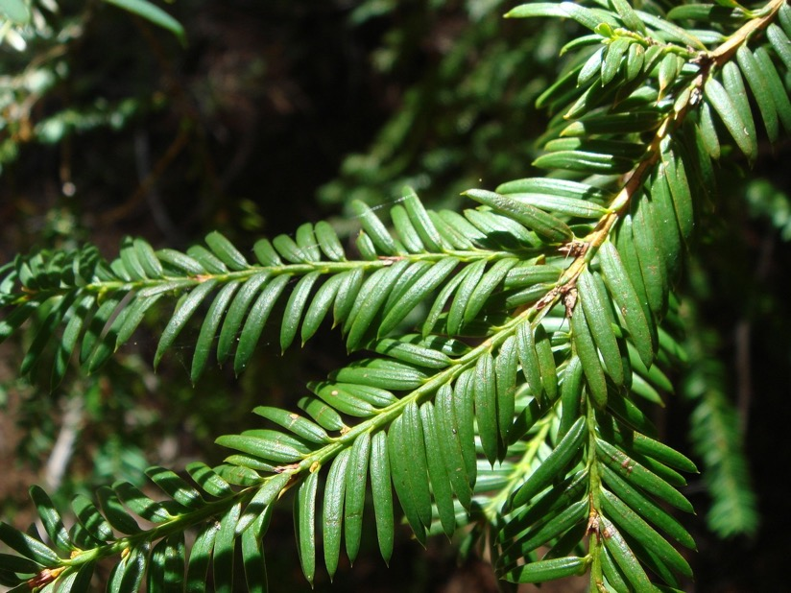
Leaves Winter berries
9.

Slide 15
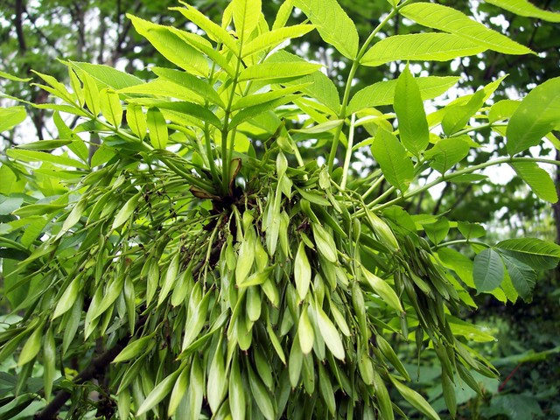
Leaves Leaves and seeds
10.

Slide 16
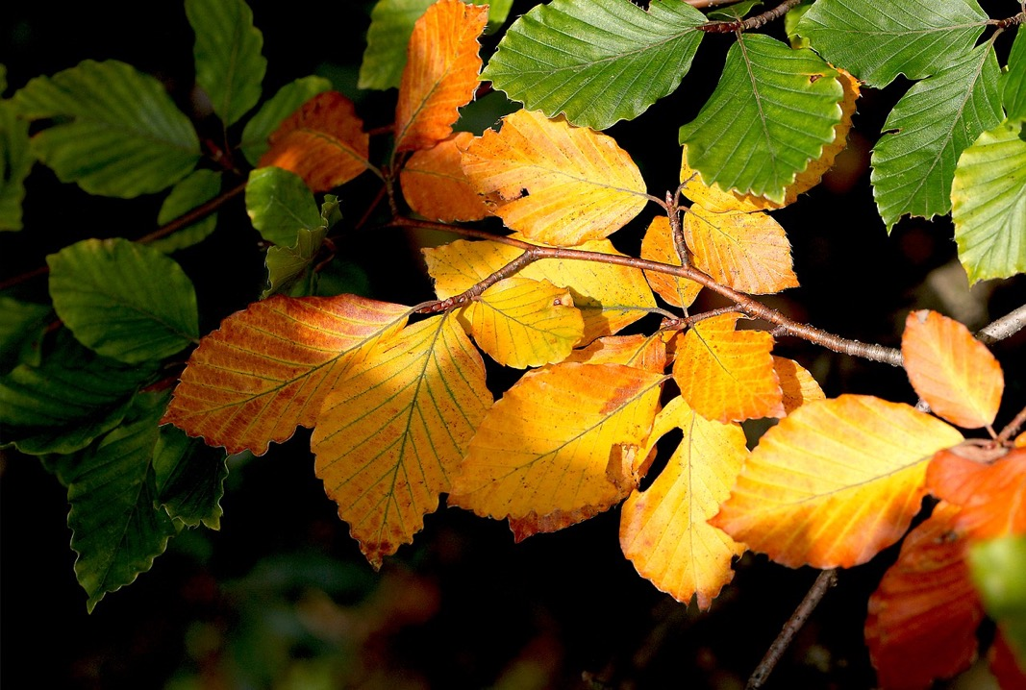
Leaf Autumn leaves
11.

Slide 17
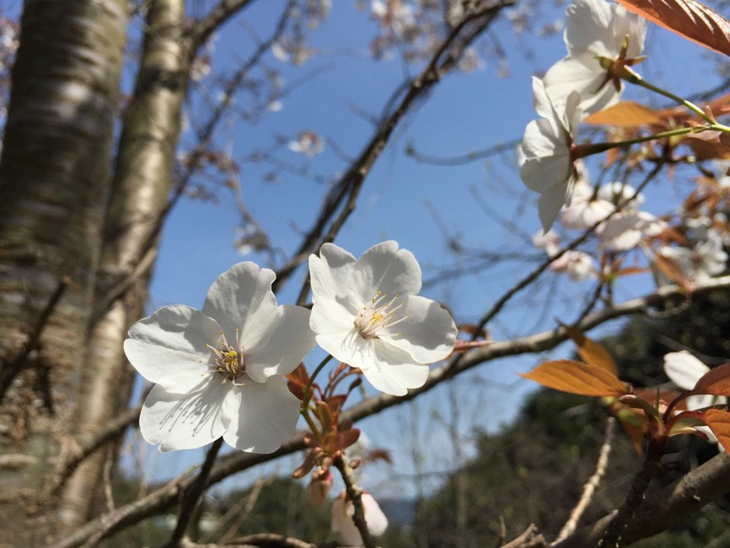
Leaves with fruit Spring blossom
12.

Slide 18
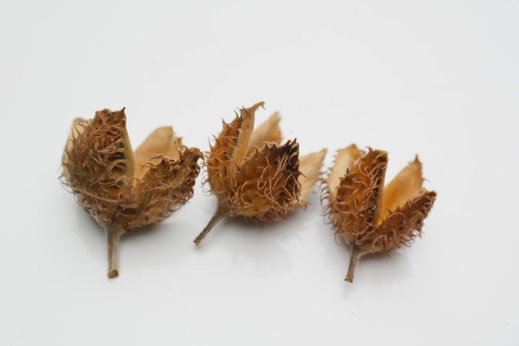
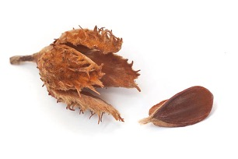
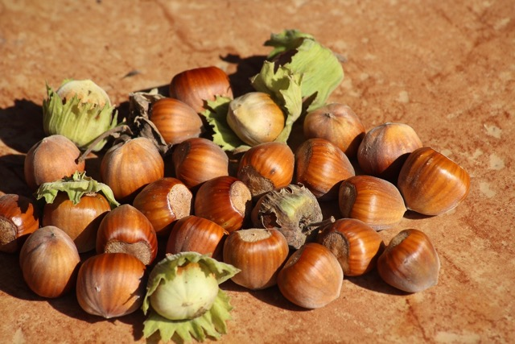
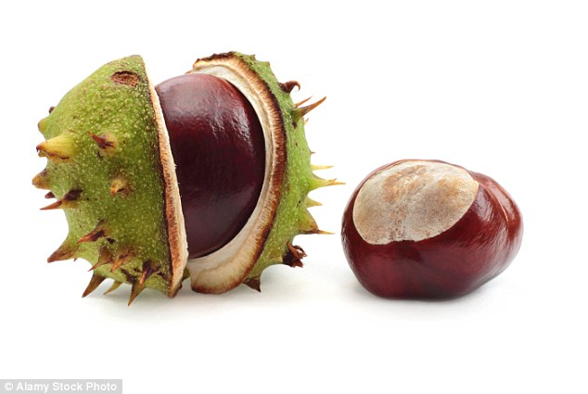
Flowers become fruits… nuts and seeds are a type of ‘fruit’
Do you know what these nuts are called?
Do you know which trees they come from?
1.
2.
3.
Can you recognise 1… 2… 3… 4… or none?
4.

Slide 19
Here are some tree names to help you…
Which tree do I grow on?
Beech
Horse Chestnut
Oak
Hazel
1.
2.
3.
Now how many can you name…?
4.

Slide 20
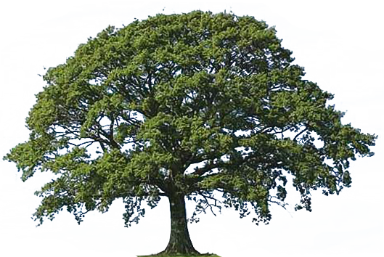
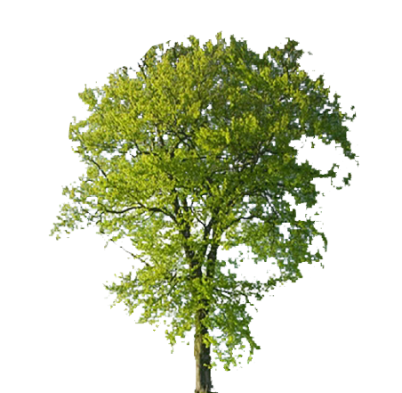
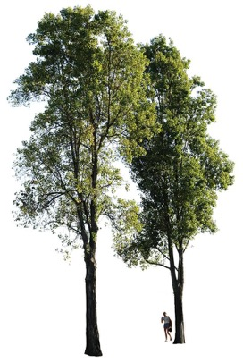
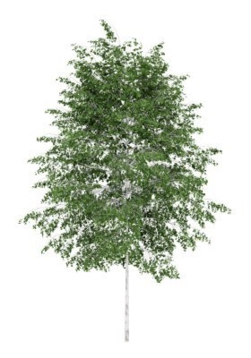
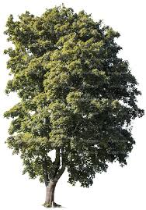
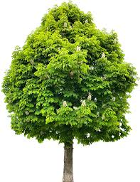
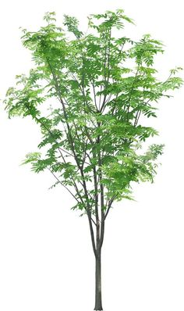
Thank you for doing our quiz
You are going to be doing lots of games and activities to help you to learn to
identify British native trees.
Your target is 6 trees!
Could you beat that target?

Slide 21
For teachers’ eyes only!
1. Silver birch 9. Yew
2. Field maple 10. Ash
3. Hawthorn 11. Beech
4. Hazel 12. Wild cherry
5. Holly
6. Horse chestnut Nuts!
7. Oak 1. Oak 2. Beech
8. Rowan 3. Hazel 4. Horse chestnut

